Slide 1

Food Deserts in the Nashville Area
Jessica Morrison
NSS Data Analytics Cohort 3

Slide 2
Motivation:
Upon moving closer to the city, I noticed that there was a lack of grocery stores in the area. I then wondered how the lack of fruits and vegetables would affect individuals both physically and economically. With this analysis, I hope to find out if there is a lack of fruits and vegetables in the Nashville area and if there is, how does it affect individuals. And if there is an effect, who is affected, and how we as a city can combat this issue.

Slide 3
Questions asked prior to analysis
What age/race/gender typically reside in a food desert?
Do lower income citizens have a higher rate of residing in a food desert or do higher income citizens have higher access to fruits and vegetables?
How does residing in a food desert have an affect on one's education?

Slide 4
The Focus
Looked at student data that was specific to the Davidson county area
Looked at grade levels ranging from Pre-K through the Twelfth Grade
Did not include Asian students given the small population
Looked up Grocery Stores/ Supermarkets located in Davidson county- Used keywords "grocery" and "supermarket" to request data using Google API

Slide 5

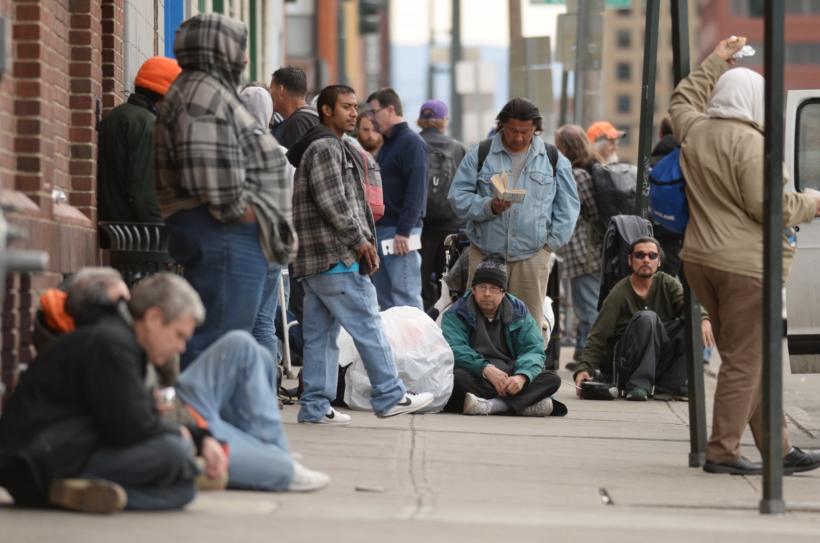

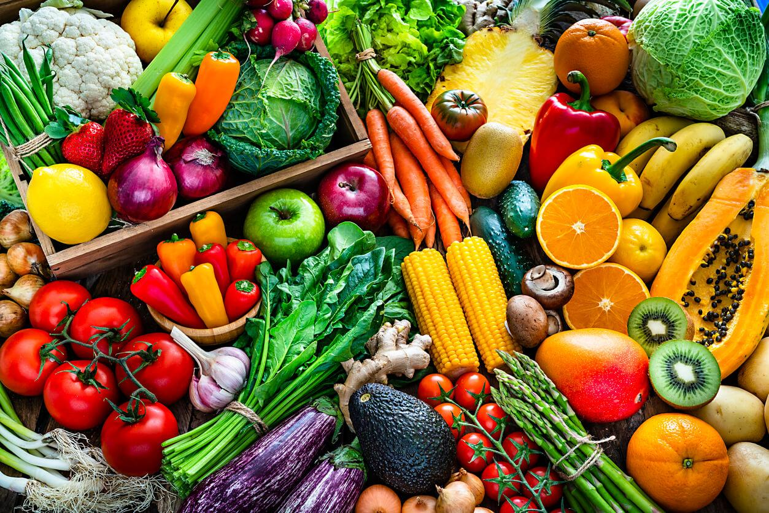

What is a Food Desert?
USDA defines a food desert as an area/region that does not have fresh fruits and vegetables available within a community.
*Photo by Hyoung Chang Denver post

Slide 6
Which Davidson County students are Economically Disadvantaged ?

Slide 7
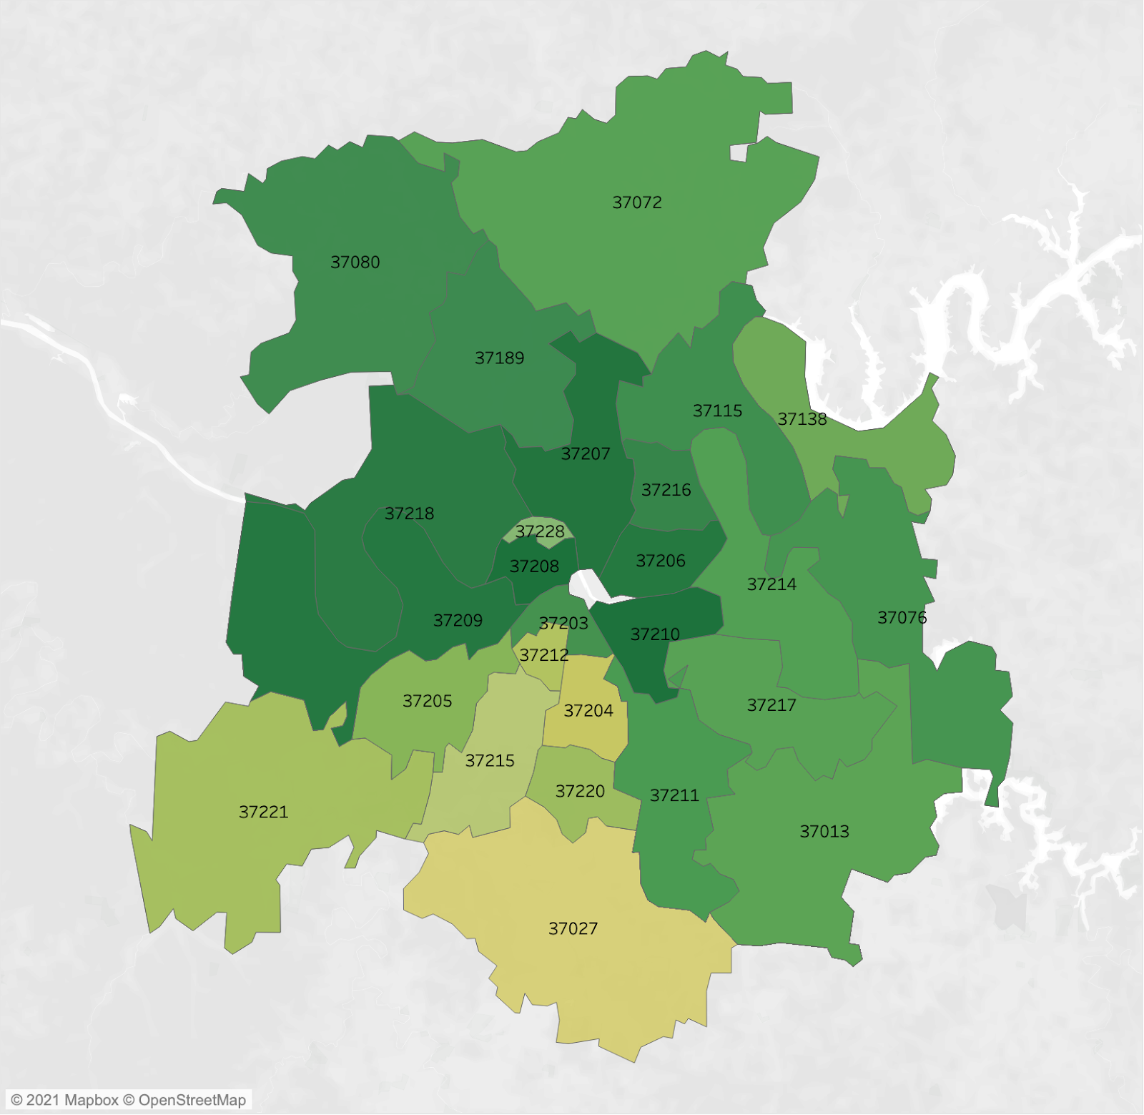
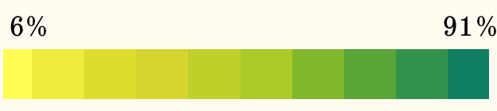
Economically Disadvantaged Students by Zip
Color gradient indicates the level of poverty by zip code

Slide 8
Zip codes with higher Economically Disadvantaged students
37208- North Nashville
37210-South Nashville
37218/37209- Northwest and Southwest of Cumberland River
37206- East Nashville
37207- North-East of Cumberland River
Note: 37228-Metrocenter/North Rhodes Park is an outlier

Slide 9
Zip Codes with Higher Wealth
37027-Brentwood
37204- Berry Hill/ Melrose
37212- Hillsboro West End
37220- North Brentwood
37221- Bellevue
37205- Belle Meade

Slide 10


Economically Disadvantaged Students By Demographics

Slide 11
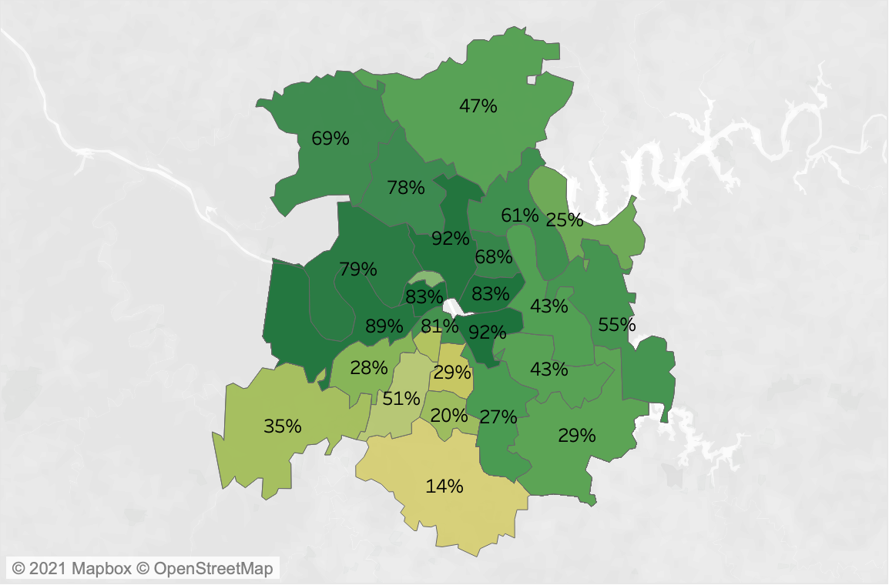
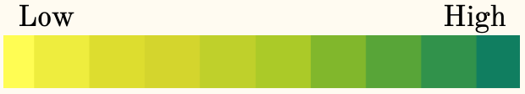
Black/ AA students vs Economically Disadvantaged
Numerical amount represents the percentage of given students by zip while the color gradient indicates the level of poverty by zip code (K-12)

Slide 12

Hispanic /Latino students vs Economically Disadvantaged
Numerical amount represents the percentage of given students by zip while the color gradient indicates the level of poverty by zip code (K-12)

Slide 13

White/Caucasian students vs Economically Disadvantaged
Numerical amount represents the percentage of given students by zip while the color gradient indicates the level of poverty by zip code (K-12)

Slide 14
In the next steps, we will compare the student data to grocery store locations in the Davidson County area

Slide 15
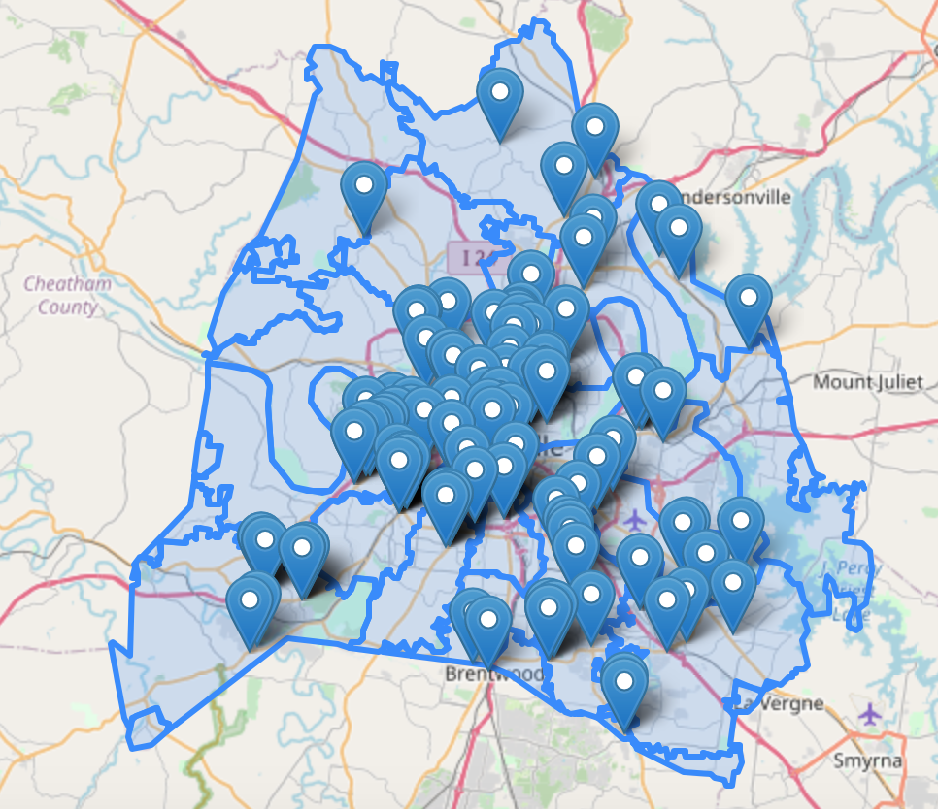
Grocery stores/ Supermarkets in the Davidson county area

Slide 16
Black/ AA students vs Economically Disadvantaged in comparison to grocery store locations
*Shape differences may be due to how the Davidson county school district is zoned- Left image represents school data

Slide 17
Hispanic /Latino students vs Economically Disadvantaged in comparison to grocery store locations

Slide 18
White/Caucasian students vs Economically Disadvantaged in comparison to grocery store locations

Slide 19

Does this affect a students future?
We will look into some US Census Data to see Educational Attainment statistics in the Davidson county area

Slide 20
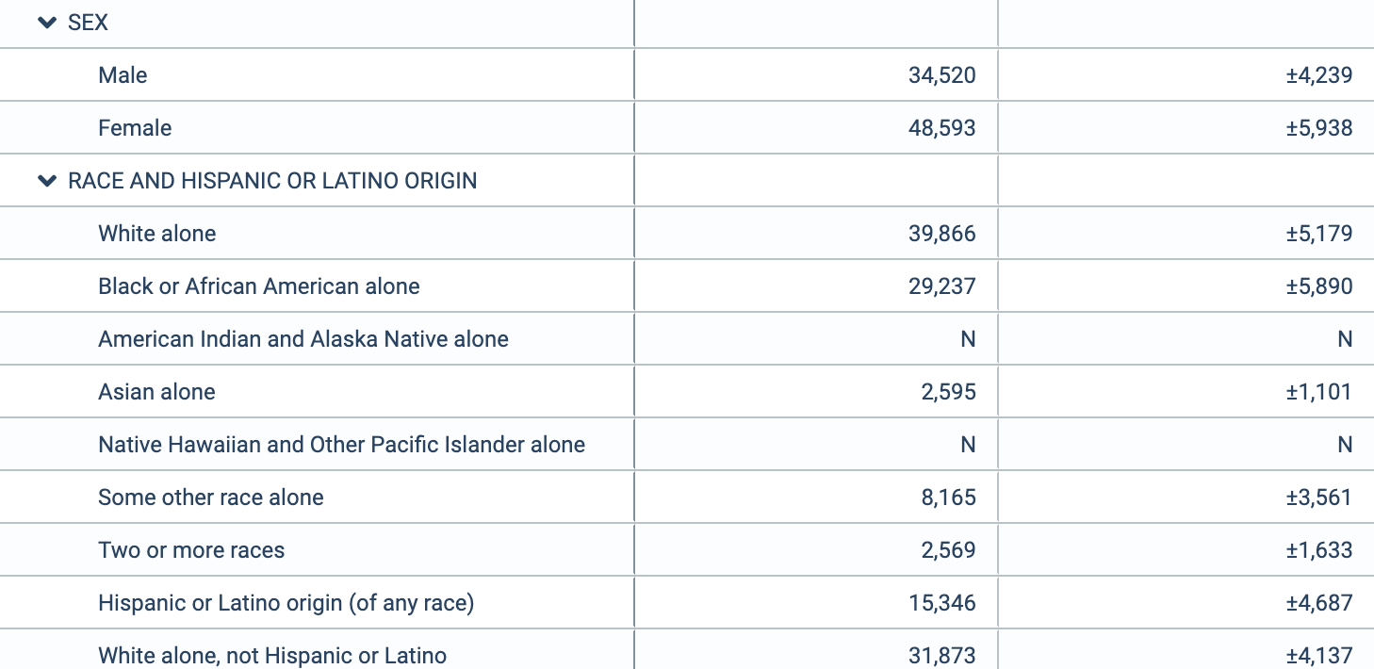
Below Poverty level Stats for Davidson County-all ages

Slide 21
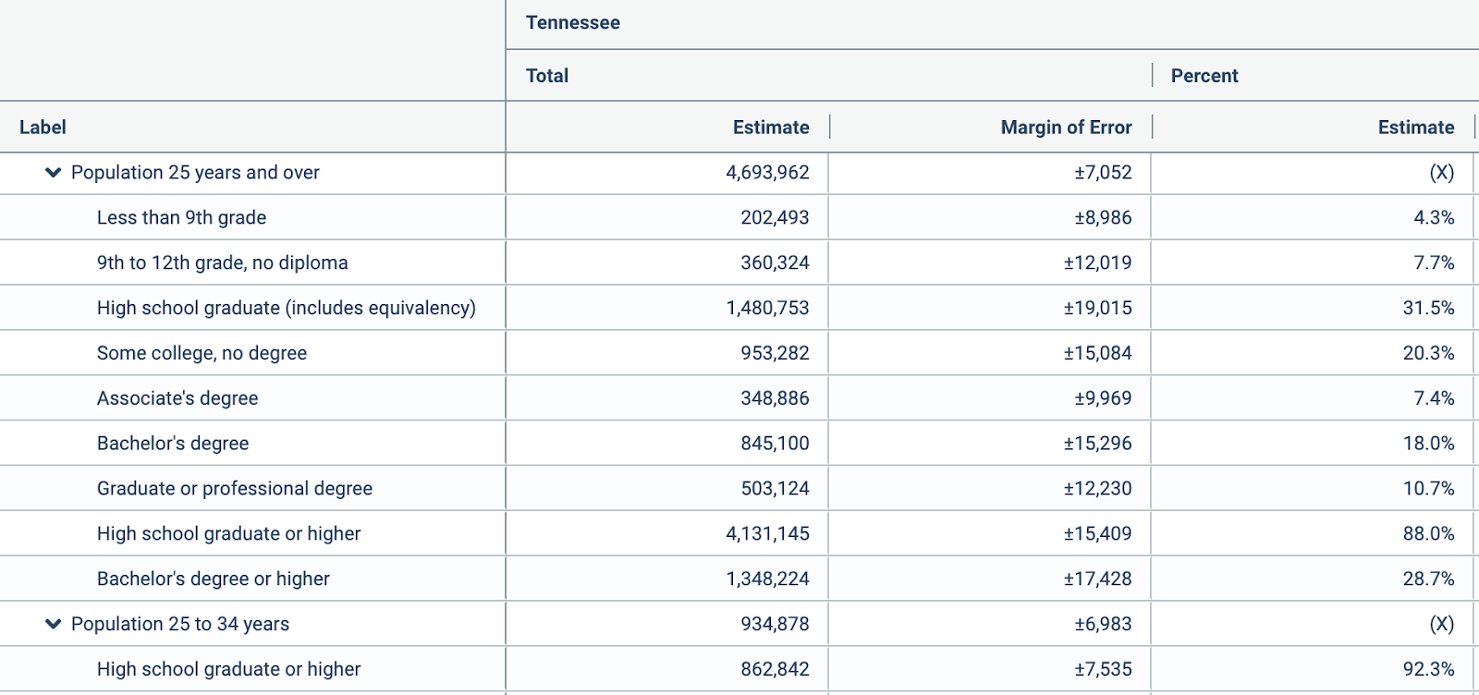
Educational Attainment for the State of Tennessee : Population 25 yrs. and older

Slide 22
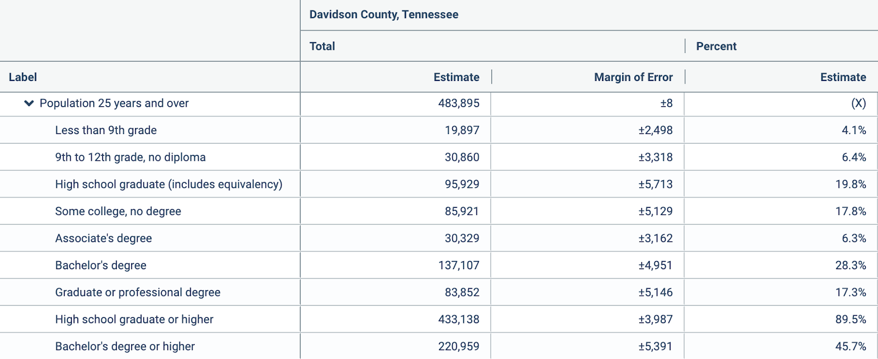
Educational Attainment for Davidson County: Population 25 yrs. and older

Slide 23
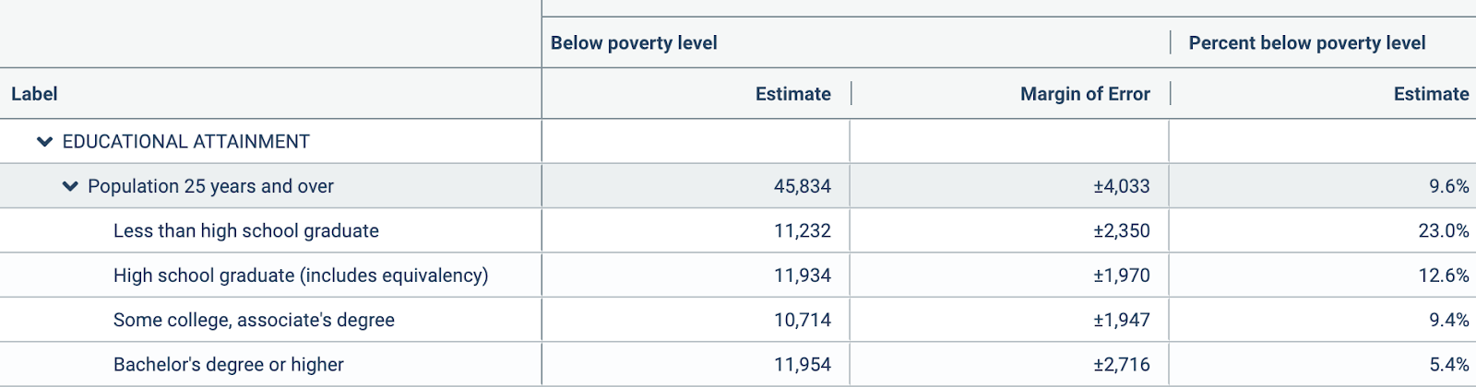
Individuals Below Poverty level who attained an Education-Davidson County

Slide 24
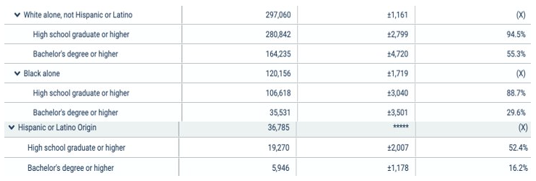
Education Attainment by Race -Davidson County

Slide 25
What have we discovered?

Slide 26

Analysis
Black/AA students are the most economically disadvantaged students in Davidson County
Students residing in the North and South West region of the Cumberland River, zip codes 37218/37209, live in a food desert. These areas are also economically disadvantaged and had a high number of Black/AA students.
Whites Creek zip code 37189 and Joelton, zip code 37080 also seemed to be food deserts and also had a high number of Black/AA students.

Slide 27
Analysis (cont.)
Goodlettsville, zip code 37072, and zip code 37076 or Hermitage was towards the middle of the gradient scale and did not show many grocery stores within the area. Students within this area were Black/AA
Though zip code 37221(Bellevue) leaned towards the higher end of the amount of economically advantage students, this area also had spots where stores were not near. Students within this area were White/ Caucasian
It must be noted that the economically disadvantaged zip codes had a large number of stores in the area, but it is hard to tell if many of the listed stores provide healthy fruits and vegetables
In regards to Davidson County's residents Education Attainment, about 85% of Davidson county residents obtained a High school diploma and 45% received a College diploma. While 12.6% of residents under the poverty line obtained a High school diploma and 5.4% obtained a College degree. With this, we can note that many under the poverty line do not have a degree that may allow them to raise their economic status. But is there a correlation?

Slide 28


What does this all mean?

Slide 29
Conclusion
Most of the food deserts resided in economically disadvantaged zip codes but Bellevue, which is higher on the scale, also could be considered a food desert and could be seen as an outlier.
Black/ African-American students showed to have a higher chance living in a food desert but as previously stated, zip codes with higher disadvantaged students who had a large Black/AA population, had a higher amount of grocery stores compared to students who were in economically advantaged zip codes.

Slide 30
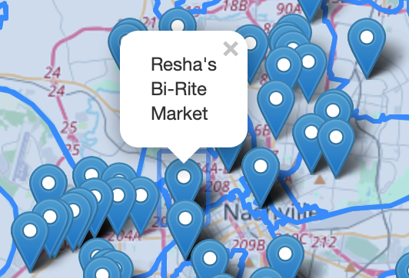
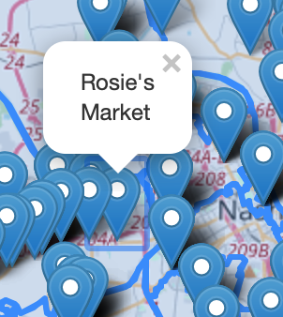
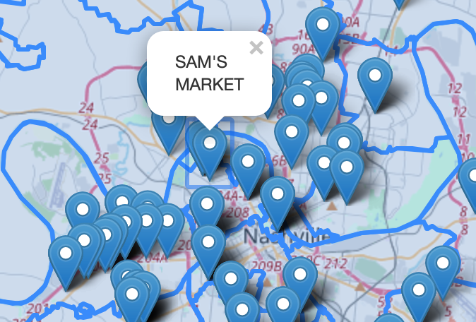
Conclusion (cont.)
It is hard to say if the grocery stores listed provide fruits and vegetables in economically disadvantaged neighborhoods. When one searches for Grocery Store/ Supermarket within Google Maps, Google may pick up a convenience store which could skew the data.

Slide 31
Conclusion (cont.)
It is also important to note that though White/Caucasian residents had a higher College Degree attainment rate in comparison to Black/AA and Hispanic/Latino residents, they also had the highest below poverty rate.
With this, it is hard to say if there is a correlation between education and living in a food desert.

Slide 32

But...there are still Food Deserts

Slide 33
Next Steps
One may want to complete the US Census form so more stores can move into the area
1
Notify your local government
2
Write to stores asking them to bring business into the area
3
Help out your fellow neighbor by donating to a local food bank
4

Slide 34
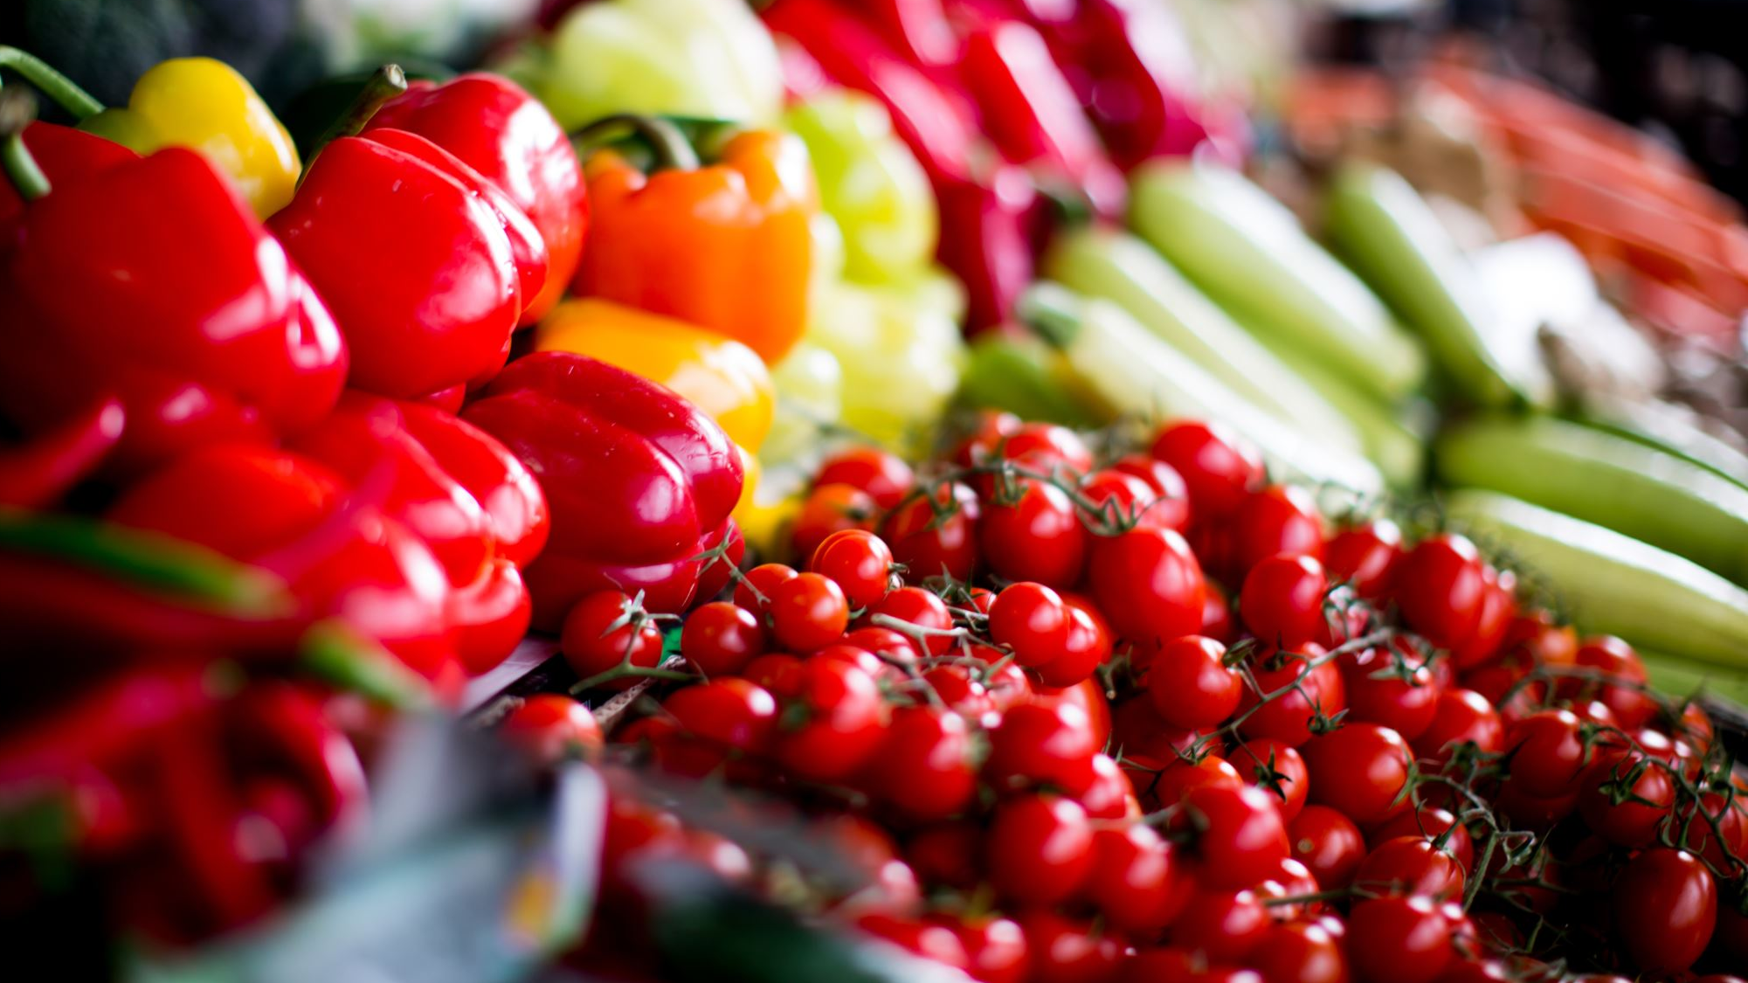
Though one may not be able to fully know if there is a correlation between a food desert and ones' ability to obtain a higher education , the fight to end hunger by recognizing where food deserts exists is still key and is an important piece towards a better Nashville.

Slide 35

Questions?

Slide 36
Tools Used-Process
Used Google API to retrieve Grocery store/Supermarket Data
-Broke up API searches based on Lat/Long of North, East, South, West areas of Davidson county
Used Python to clean up grocery store data and to create the Folium maps
Used Tableau to create Color Gradient maps

Slide 37
References- Data from..
Metro Nashville Public Schools Open Data
https://data.nashville.gov/Education/Metro-Nashville-Public-Schools-Open-Data/dfdd-wpcd
United States Census- Educational Attainment
https://data.census.gov/cedsci/
USDA-Economic Research Service : Definitions https://www.ers.usda.gov/data-products/food-access-research-atlas/documentation/#definitions
US Department of Health and Human Services: Poverty Guidelines
https://aspe.hhs.gov/poverty-guidelines

